Slide 1
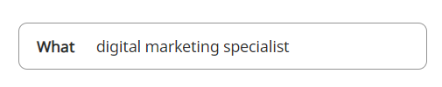

How to Navigate Job Boards
1. Type in the search bar the
title of the position you are seeking.
2. Filter based on your requirements.
Part-time, full-time, contract
Location (city/state) or remote
Salary range
Date posted
Specific company
Experience level
To narrow your search parameters add filters and to broaden your search add less filters
Use the Advanced search options to continue to narrow the field of your search parameters
QA Engineer

Slide 2

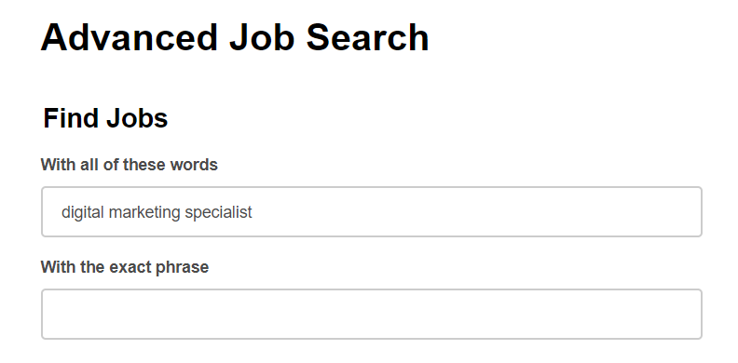
3. To narrow your search parameters, add filters; to broaden your search, add fewer filters.
4. Use the advanced search options to continue narrowing your search parameters.
Click “Advanced Job Seach”
5. Fill out options to narrow your
search parameters.
QA Engineer

Slide 3
Boolean Searches
Boolean operators help refine and narrow your search results:
OR In the following example, OR finds all jobs where either the word quality assurance or engineer appears: Example: quality assurance OR engineer
AND Retrieves all jobs that have both the words quality assurance and engineer: Example: quality assurance AND engineer
* Replaces one or more letters at the end of the word: Example: eng* will show results for engineering, engineers, engineer.
“ “ Use quotes to search the exact phrase as typed and in order: Example: “quality assurance engineer”
( ) Use ( ) to do a complex search for a combination of terms: Example: project (manager OR coordinator)
Notes:
.

